Slide 1
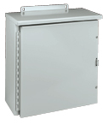
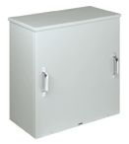
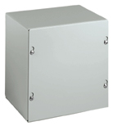
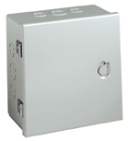
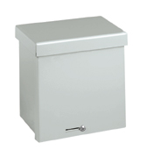
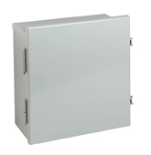
Hubbell Wiegmann
Commercial Product Offering

Slide 2
Introduction
Don Nicholas
Engineering Manger
15 years with Hubbell
5 years with Killark in St. Louis, MO
10 years with Wiegmann in Freeburg, IL
Travis Miller
Brand Manger
1 year with Hubbell Wiegmann

Slide 3
Commercial Products
What are commercial products?
Usually Type 1, 3R, or both 1 & 3R rated
Cheaper to make commodity type enclosures
Spot welded together as opposed to seam welded and ground
Usually have no gasket or partial gasket
Smaller steel gauges
Unpainted pre-galvanized or ANSI 61 painted carbon steel.
Many commercial enclosures are offered with pre-punched concentric knockouts for easy conduit entry
Example applications are:
Junction boxes
Metering cabinets
Panel enclosures
Wireway and gutters

Slide 4
Commercial Products
What does Type 1 and 3R mean?
They are NEMA environmental type ratings that state in what environmental location these enclosures can be installed.
Type 1
General purpose enclosures constructed for indoor only use. Protects against dust (but not dust tight), light, and indirect splashing.
It primarily prevents incidental contact with the equipment inside.
Type 3R
Enclosures constructed for either indoor or outdoor use. Provides a degree of protection against falling rain, sleet, snow, and dripping water. (but not water tight)
Usually doesn’t have a gasket to keep maintain a seal
We certify to both UL and CSA standards through UL which is technically classified as a cULus certification.

Slide 5
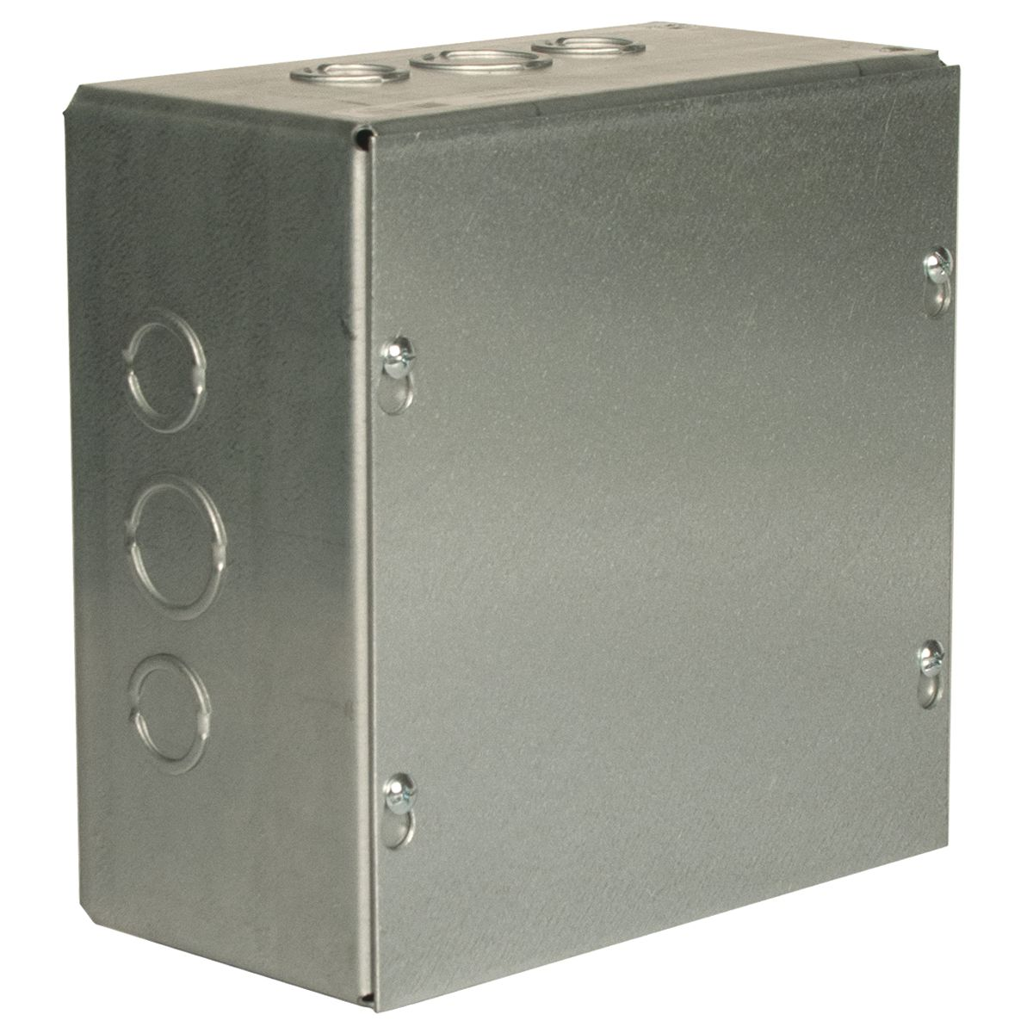
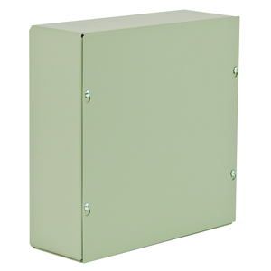
SECTION A – NEMA 1 Enclosures
SC Series (Screw Cover)
The SC series is a Type 1 rated enclosure where a flat lid is secured with screws. The screws do not need to be fully removed to take off the lid due to a teardrop style cutout.
Application
Designed for use as a junction and pull box for commercial and general industrial applications.
Specifications
Sizes offered range from 4”x4”x4” up to 48”x48”x18”
Manufactured in both galvanized steel and carbon steel painted ANSI 61 gray texture
Offered with or without concentric knockouts up to 24”x36”x12”
Back Panel
N/A

Slide 6
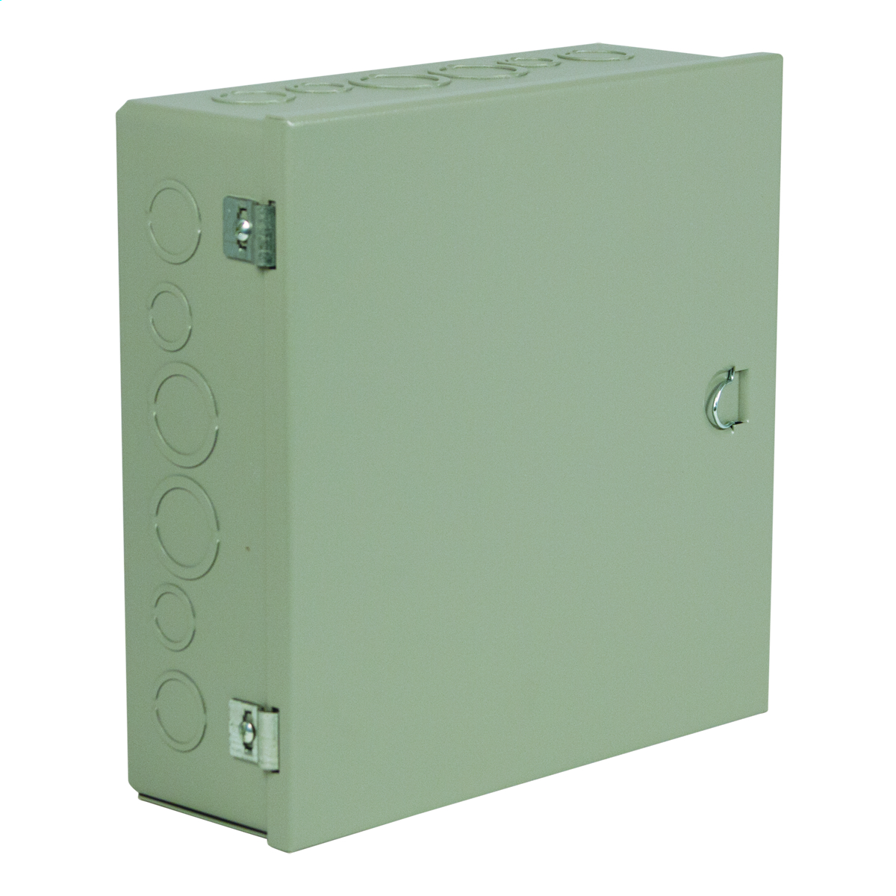
SECTION A (cont’d)
A Series
The A series enclosures are rated Type 1. They use the same tub as the screw cover enclosures but have a hinged cover. They are secured shut with a friction catch and have a pull tab for easy access to the components inside.
Applications
Designed for use as a surface mounted junction box, switch box, or cutout box. Best used in an application where internal components must have regular access.
Specifications
Sizes offered range from 5”x4.5”x3” up to 36”x24”x8”
Manufactured from carbon steel painted ANSI 61 gray texture.
All sizes have concentric knockouts
Back Panel
N/A

Slide 7
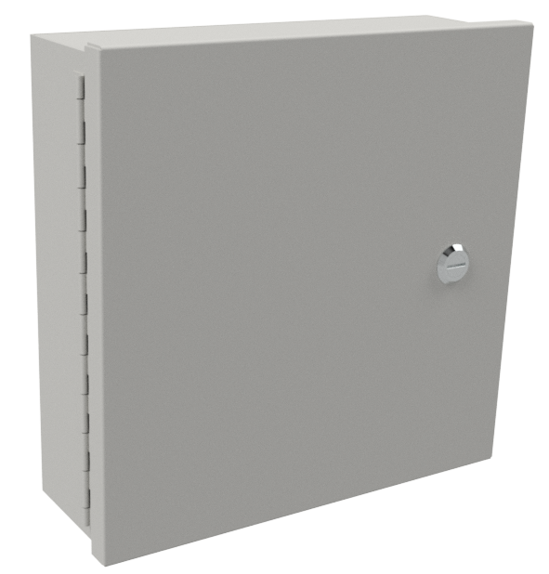
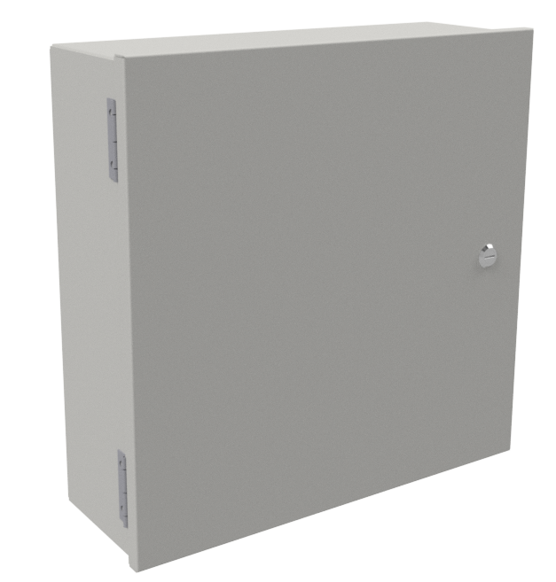
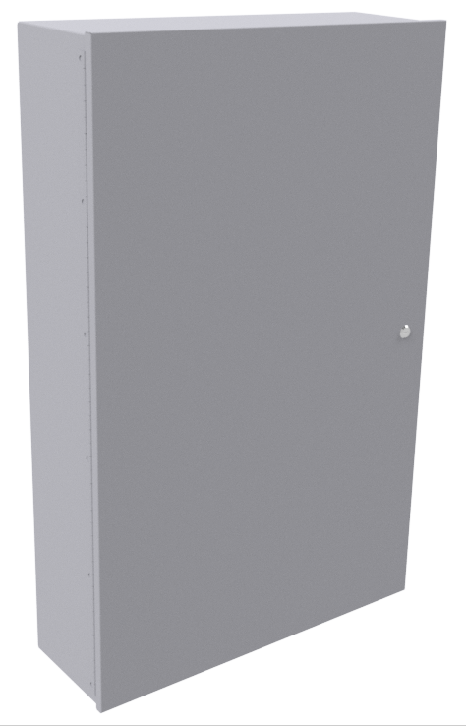
SECTION A (cont’d)
N1C Series
The N1C wallmount series enclosures are rated Type 1 and are separated into small, medium, and large categories. The door is hinged and secured shut with a quarter turn latch. They also have provisions for mounting a back panel.
Applications
Designed for use as control enclosures and instrument cases in areas NOT requiring oil tight and dust tight specifications. Preferred choice when a back panel is needed for the application.
Specifications
“Small” sizes range from 6”x6”x4” to 14”x12”x8”. Has a continuous hinge and weld nuts for optional back panel
“Medium” sizes range from 16”x12”x6” to 36”x24”x8”. Has butt hinges and collar studs for optional back panel.
“Large” sizes range from 42”x30”x9” to 48”x36”x17”. Has a continuous and collar studs for optional back panel.
Internal mounting provisions
Manufactured from carbon steel painted ANSI 61 gray texture.
Back Panel
“Small” and “Medium” sizes use an N1P style panel
“Large” sizes use an NP style panel

Slide 8
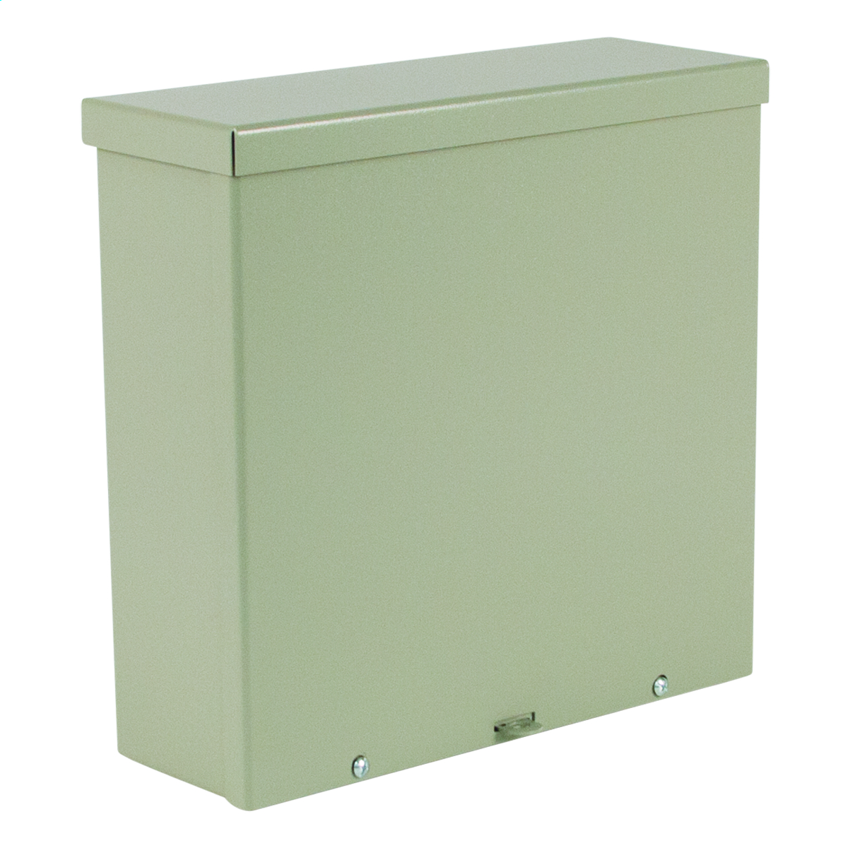
SECTION B – NEMA 3R Enclosures
RSC Series (raintight screw cover)
The RSC wall mount series enclosures are rated Type 1 & 3R. They have a reversible slip on lid secured with screws. The top has a drip shield that covers both the lid and tub to maintain the 3R rating.
Applications
Designed for use as wiring boxes and junction boxes. Provide protection in outdoor applications against rain, sleet and snow or indoors against dripping water.
Specifications
Sizes offered range from 4”x4”x4” up to 36”x36”x18”
Material offering in both galvanized steel and carbon steel painted ANSI 61 gray texture
Offered with concentric knockouts, only in the bottom, up to 24”x24”x6”, also only on the 4” and 6” deep enclosures
Fold-away hasp for padlock or meter seal is provided
Internal mounting holes
Back Panel
N/A

Slide 9
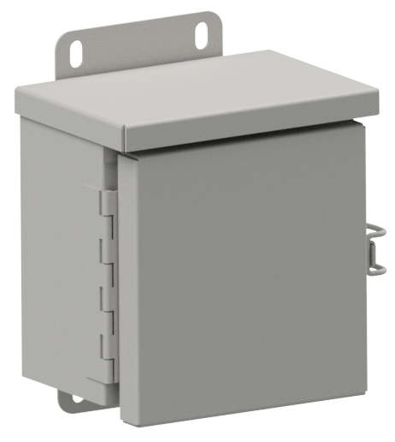
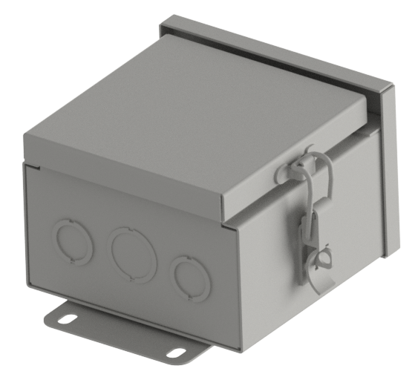
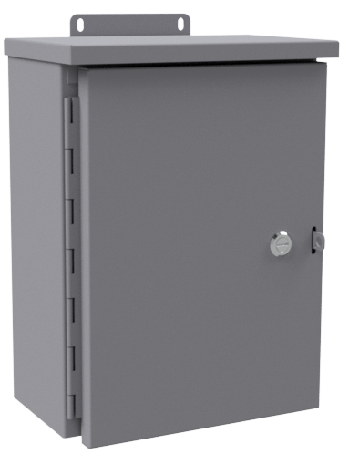
SECTION B (cont’d)
RHC Series (raintight hinged cover)
The RHC wall mount series enclosures are rated Type 1 & 3R and are separated into small and medium categories. They have a continuous hinge and a drip shield that covers both the lid and tub to maintain the 3R rating.
Applications
Designed for use as wiring boxes and junction boxes where quick access to the internal components is necessary. Provide protection in outdoor applications against rain, sleet and snow or indoors against dripping water.
Specifications
“Small” sizes range from 6”x6”x4” to 12”x12”x6”. Has concentric knockouts in the bottom, quick release latch with padlocking provision, and weld nuts for optional sub panel
“Medium” sizes range from 16”x12”x6” to 48”x36”x16”. Does not have knockouts. Is secured with a quarter turn latch, has a fold-away hasp for a padlock or meter seal, and collar studs for optional sub panel.
Manufactured from carbon steel painted ANSI 61 gray texture.
External pads for mounting enclosure
Back Panel
“Small” sizes use an N1P style panel
“Medium” sizes use an NP style panel

Slide 10
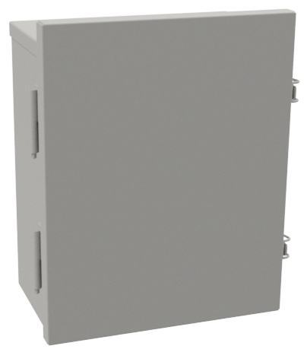
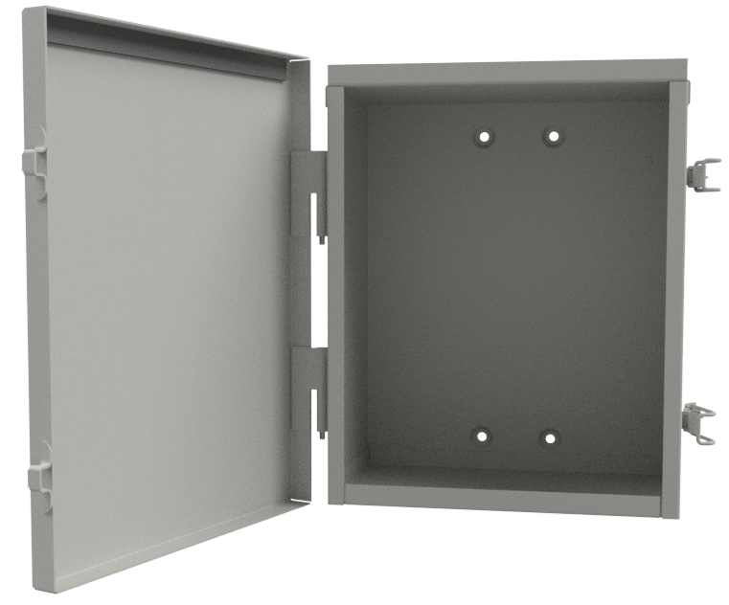
SECTION B (cont’d)
LOH Series (lift-off-hinge)
The LOH wall mount series enclosures are rated Type 1 & 3R. The lid is secured with quick release latches and special hinges to allow a user to easily remove the it from the tub. The top has a drip shield to maintain the 3R rating.
Applications
Designed for use as wiring boxes and junction boxes where quick access to the internal components is necessary. Provide protection in outdoor applications against rain, sleet and snow or indoors against dripping water.
Specifications
Offered in sizes from 8”x6”x4” up to 30”x24”x8”.
Manufactured from carbon steel painted ANSI 61 gray texture
Quick release latch with padlocking provision
Internal mounting holes (optional external mounting foot kit sold separately)
Optional panel mounting kit sold separately (square knockout provided if used)
Back Panel
8”x6”x4” to 16”x12”x6” sizes use a P style panel
16”x16”x6” to 30”x24”x8” sizes use an NP style panel

Slide 11
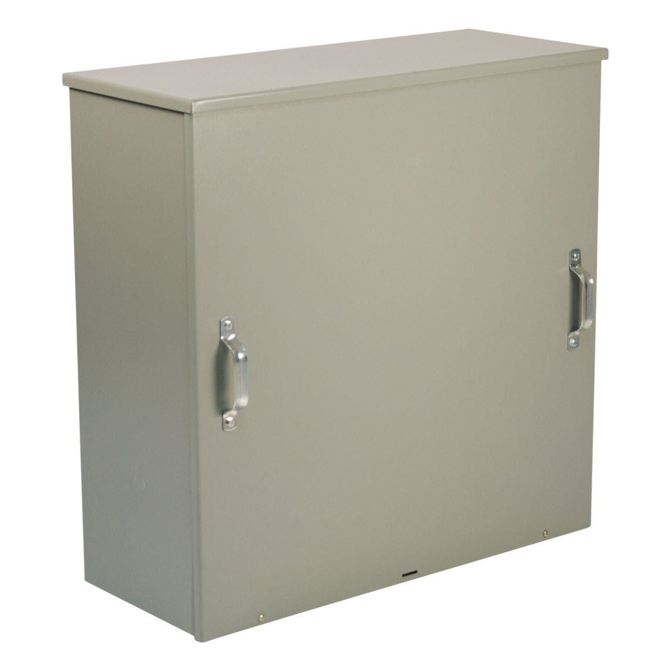
SECTION B (cont’d)
WCT Series
The “WCT” screw cover transformer wall mount series is rated Type 1 and 3R. The slip on lid is secured to the tub with. The lid has handles for ease of removal and re-installation and the top has a drip shield installed to maintain the 3R rating.
Applications
Designed for use as transformer housings, junction boxes and service boxes. Provide protection in outdoor applications against rain, sleet and snow or indoors against dripping water.
Specifications
Offered in sizes from 24”x24”x12” up to 48”x36”x16”.
Manufactured from carbon steel painted ANSI 61 gray texture
Internal mounting holes provided
Fold-away hasp for a padlock or meter seal
Back Panel
N/A

Slide 12
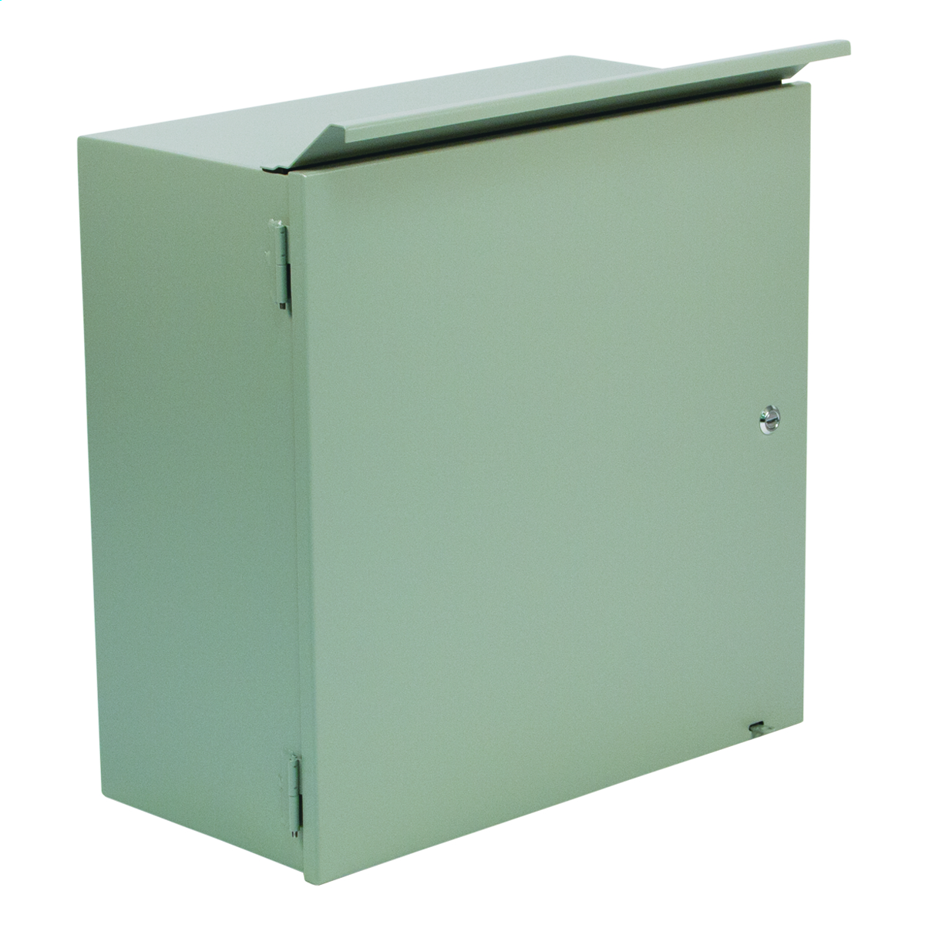
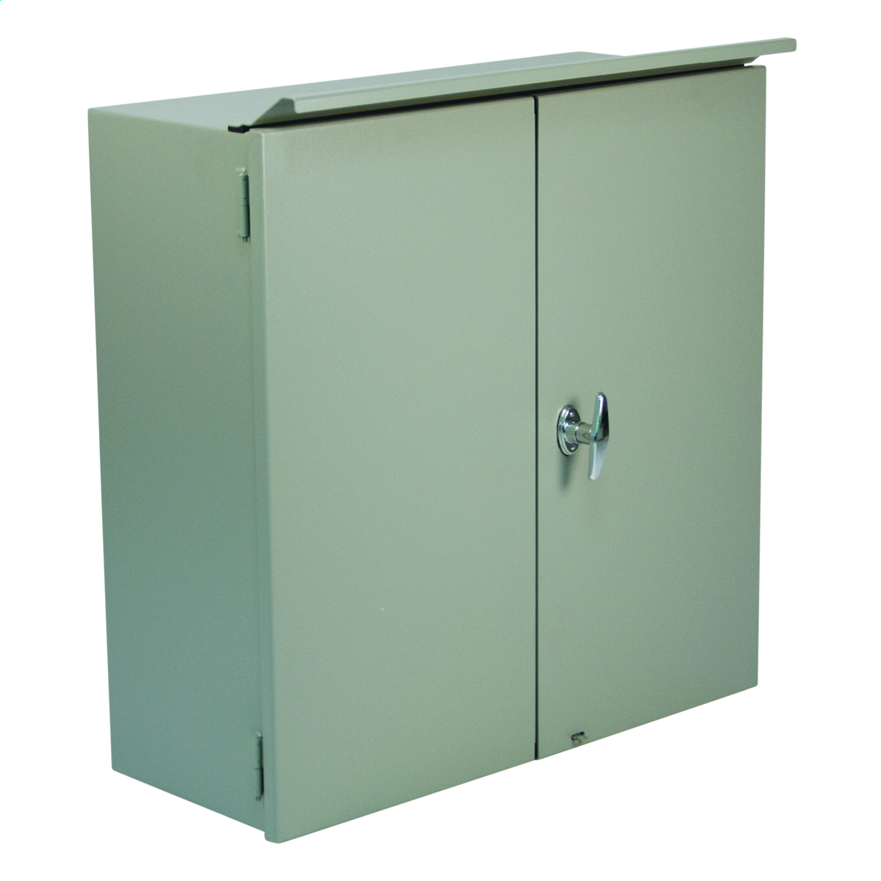
SECTION B (cont’d)
CTSD & CTDD Series
The “CTSD” and “CTDD ” series are single door and double door hinged cover transformer wall mount enclosures and are rated Type 3R. The single door is secured to the tub utilizing lift off hinges and a ¼ turn latch. The double doors are secured to the tub utilizing lift off hinges and a 3-point ¼ turn T handle. The top has a drip shield installed to maintain the 3R rating.
Applications
Designed for use as a housing for current and voltage transformers, recorders, meters, junction boxes, service boxes, relay and terminal instrumentation.
Specifications
Single doors are offered in sizes from 24”x30”x10” up to 36”x30”x12”.
Double doors are offered in sizes from 18”x12”x10” up to 48”x48”x16”.
Manufactured from carbon steel painted ANSI 61 gray texture
Internal mounting holes provided
Fold-away hasp for a padlock or meter seal
Studs supplied for optional wood back panel
Back Panel
WBP style panel

Slide 13
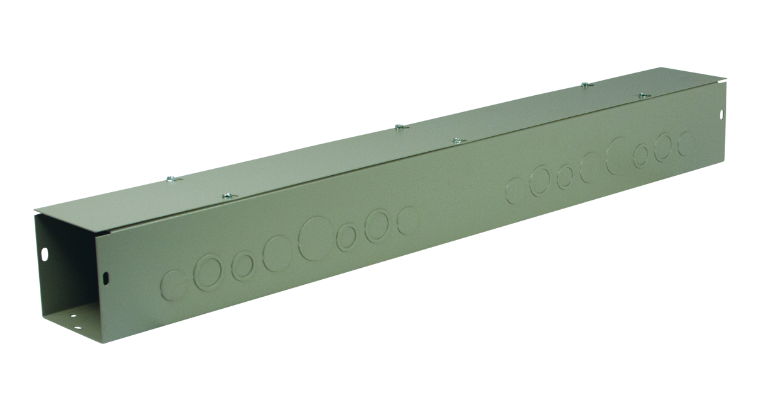
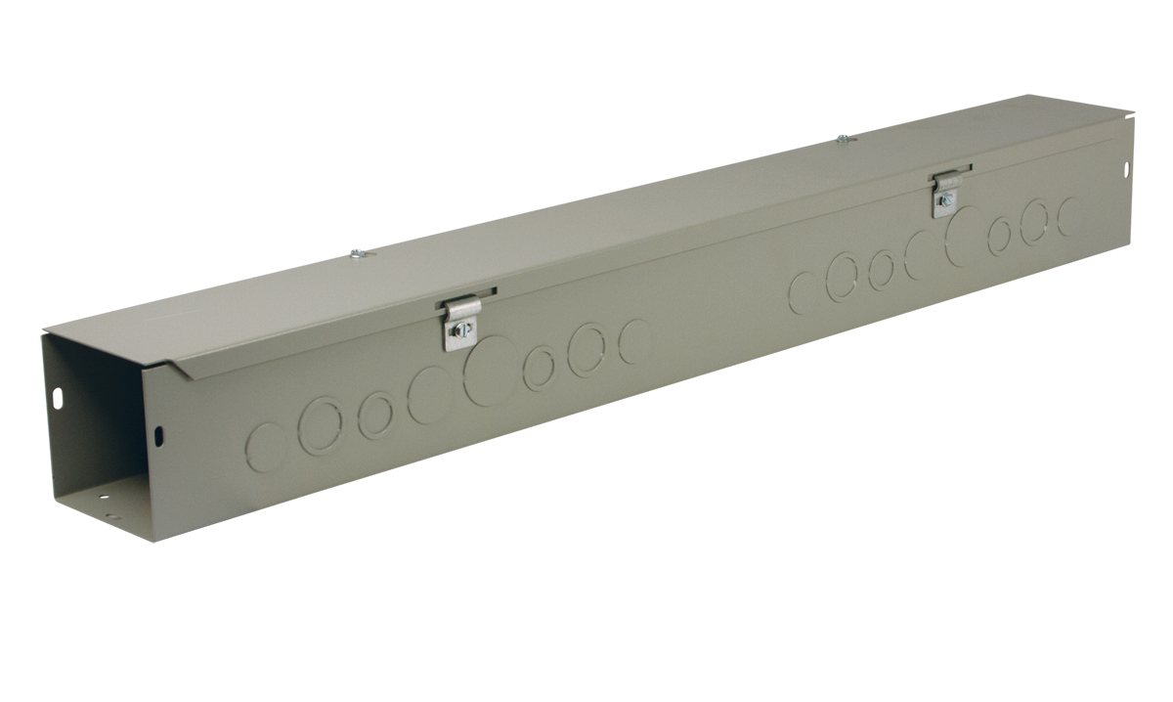
SECTION H - Wireways and Fittings
HS & S Series (hinged screw cover & screw cover wireways)
The “S” series is a Type 1 wireway where a flat lid is secured with screws. The “HS” series is a Type 1 wireway where a hinged lid is secured with screws. A wireway has open ends and is either connected to another wireway or various fittings that that allow you to run wire around obstacles. This style of wireway will allow you lay in your wire when the lid is removed instead of having to feed it through the ends.
Applications
Designed to protect electrical wiring in applications where dirt, dust, oil and water are not serious problems.
Specifications
Offered in sizes from 2.5”x2.5”x12” up to 12”x12”x120”.
Manufactured in both galvanized steel and carbon steel painted ANSI 61 gray texture
Offered both with and without concentric knockouts on the side walls
Back Panel
N/A

Slide 14
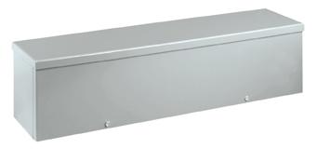
SECTION H (cont’d)
RSCG Series (raintight screw cover gutter)
The “RSCG” trough series is a Wiegmann enclosure that is rated Nema Type 3R and 1 where the slip on reversible lid is secured to the tub utilizing screws and does not have a hinged side. The top has a drip shield installed to maintain the 3R rating.
Applications
Designed to protect wiring in outdoor installations where a Type 3R rating is suitable.
Specifications
Offered in sizes from 4”x4”x12” up to 12”x12”x120”.
Manufactured from carbon steel that is coated with ANSI 61 powder coat paint or from galvanized steel
Internal mounting holes are provided.
Offered both with and without concentric knockouts on the side walls
Back Panel
N/A

